Slide 1
🎓 Final Project Project Title: German Traffic Sign Recognition Using CNNs PyTorch
Course Title: INFO 6147 Deep Learning with PyTorch
Student Name: Heba Alsharif Professor: Mohammed Yousefhussien

Slide 2
Abstract
01
Built a deep learning model to automatically classify 43 traffic sign classes using the GTSRB dataset
Intelligent Traffic Sign Recognition System
Data preprocessing + augmentation
Custom CNN architecture
Hyperparameter tuning (LR, Batch Size)
Autoencoder for noise removal
GAN for image generation
Training, validation & testing framework
02
Key Components:
03
High accuracy model suitable for real-world intelligent road systems.
Shows how CNNs + generative models improve dataset quality and safety.
Significance:

Slide 3

Project Motivation
Develop a reliable CNN for traffic sign classification
01.
Achieve high accuracy on the GTSRB benchmark
02.
Compare baseline vs improved models
03.
Build a reproducible training pipeline
04.
Use augmentation & denoising to improve generalization
05.

Slide 4
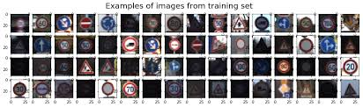
The GTSRB dataset
1. Overview
Contains 43 traffic sign classes (speed limits, warnings, prohibitions, mandatory signs)
1.1
1.2
Includes over 50,000 training images and 12,000+ test images collected under real driving conditions
2. Key Challenges in the data
Varying illumination and weather condition.
(shadows, rain, brightness changes)
2.1
2.2
Different viewing angles and perspective.
(rotation, distance, camera tilt)
Variable image quality and resolution.
(blur, noise, low contrast)
2.3
These examples demonstrate the diversity of traffic signs in the dataset and highlight challenges such as blur, shadows, and different viewing condition

Slide 5
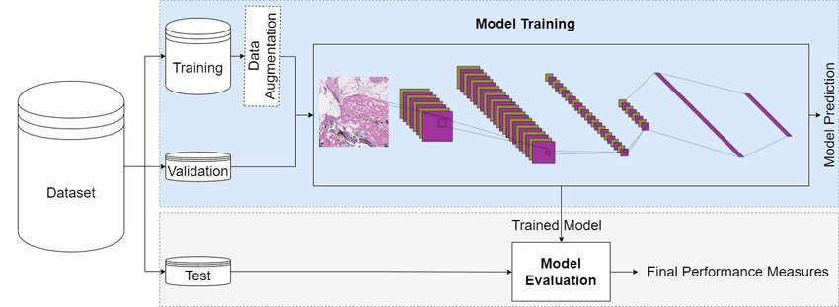
Dataset Splitting & DataLoaders
Dataset Splitting: The original GTSRB dataset is divided into Training, Validation, and Test sets to ensure reliable performance measurement.
Data Augmentation: The training set is enhanced with transformations such as rotation, horizontal flip, and color jitter to improve robustness and prevent overfitting.
Model Training: Images pass through a custom Convolutional Neural Network (CNN) where feature extraction and learning occur.
Model Evaluation: After training, the model is evaluated on unseen test data to obtain the final accuracy and performance metrics

Slide 6
Technical Data pipeline (Transformations)
Flexible loading from structured directories.
Supports train/validation/test splits
Custom Data Loader:
Resizing all images to 64×64 pixels Normalizing using standard ImageNet mean & std.
Data Processing:
Random rotation.
Random horizontal flip.
Color jitter (Brightness and Contrast variation)
Data Augmentation:

Slide 7

Technical Architecture: Model design
Custom CNN (TrafficSignCNN)
→ Three convolution blocks (32 → 64 → 128 filters). → ReLU activation + MaxPooling after each block. → Flatten → Fully connected layers with Dropout (50%). → Lightweight model (~1.5M parameters). → Designed specifically for 32×32 traffic sign images.
Transfer learning (ResNet-18)
→ Used pretrained ResNet-18 as the feature extractor backbone. → Leveraged ImageNet weights for stronger low-level & high-level features. → Frozen early layers to keep general visual knowledge. → Replaced the final classifier with a custom head (43 classes). → Used as a comparison baseline against the custom CNN.

Slide 8
Training Strategy and Implementation
Training Configuration
Regularization and monitoring
Optimizer: Adam(LR-0.001)
Dropout and batch normalization to prevent overfitting
Loss function: Cross-Entropy loss
Learning rate scheduler (ReduceLROnPlateau)
Batch size: 64
Early stopping with 5-epoch patience
Train/validation split: 80/20
Tracked loss/accuracy metrics in real-tiime

Slide 9
Results and performance analysis
Achieved high accuracy classification across all 43 categories.
Demonstrated robustness in real-world variations
Model Performance:
Model converged successfully with healthy learning curves.
Early stopping ang regularization effectively prevented overfitting.
Training behavior:
High confidence on clear standard signs.
Minor confusion between similar looking signs.
Challenges in extreme lighting and partial occlusions.
Error analysis:

Slide 10
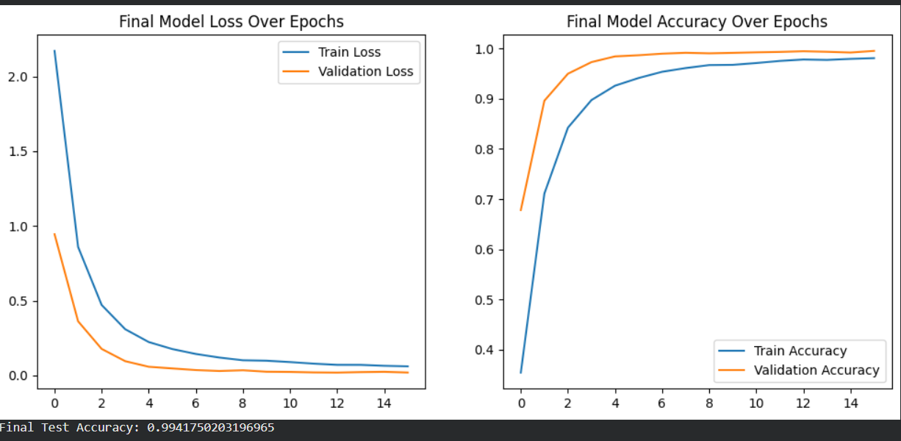
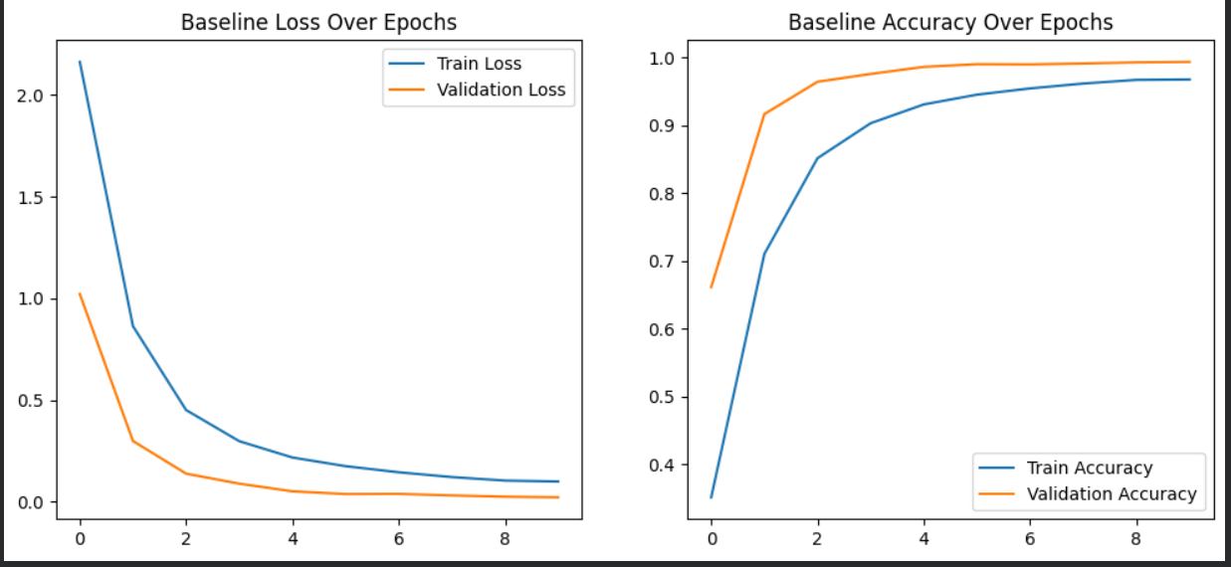
Baseline vs Final Model
Final Model:
stable curves, lower loss, higher accuracy
Baseline:
more fluctuation, higher val loss, weaker generalization

Slide 11
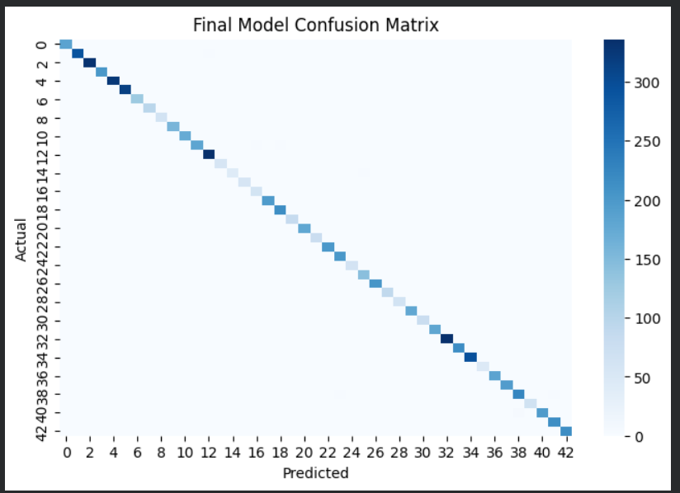
Confusion Matrix – Final Model Evaluation
Shows class-wise prediction performance for all 43 traffic sign categories
.Strong diagonal values indicate high correct classification.
Minimal confusion mainly between visually similar signs.
Confirms excellent generalization on unseen test data.

Slide 12
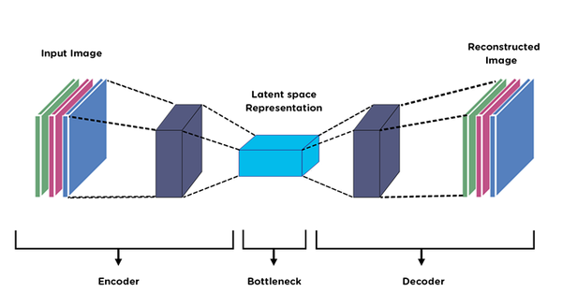
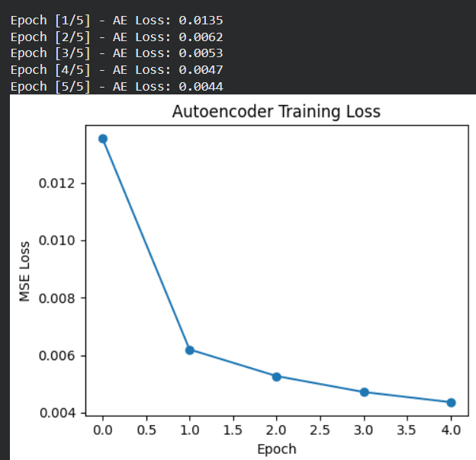
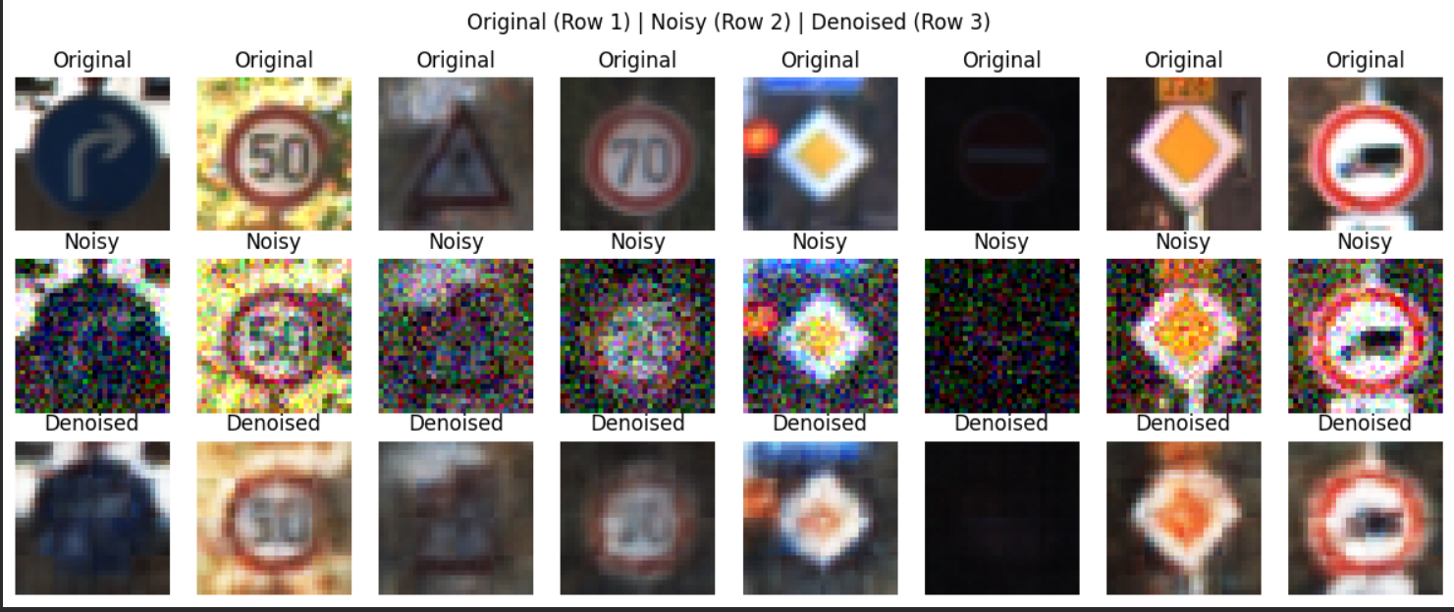
Autoencoder
A denoising autoencoder that compresses images into a latent space and reconstructs a clean version, improving robustness and feature learning."

Slide 13
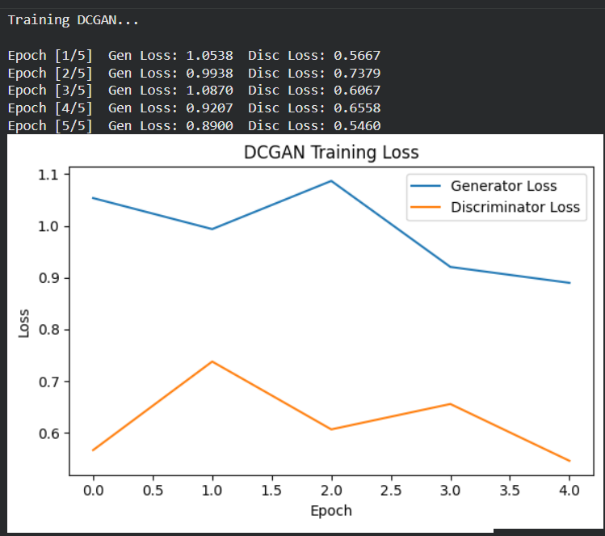
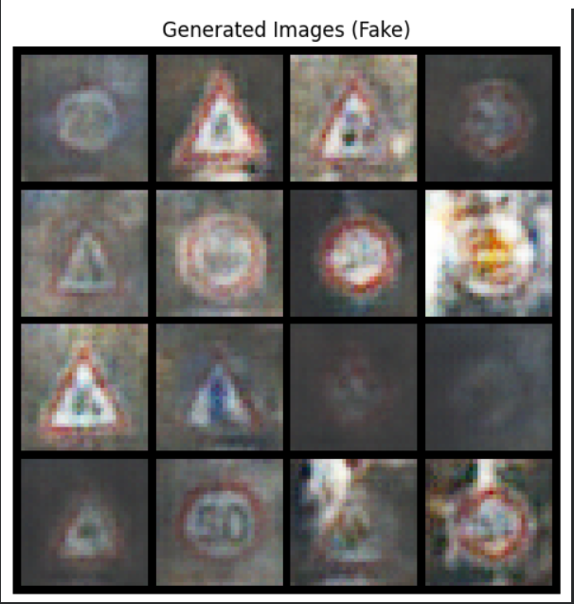
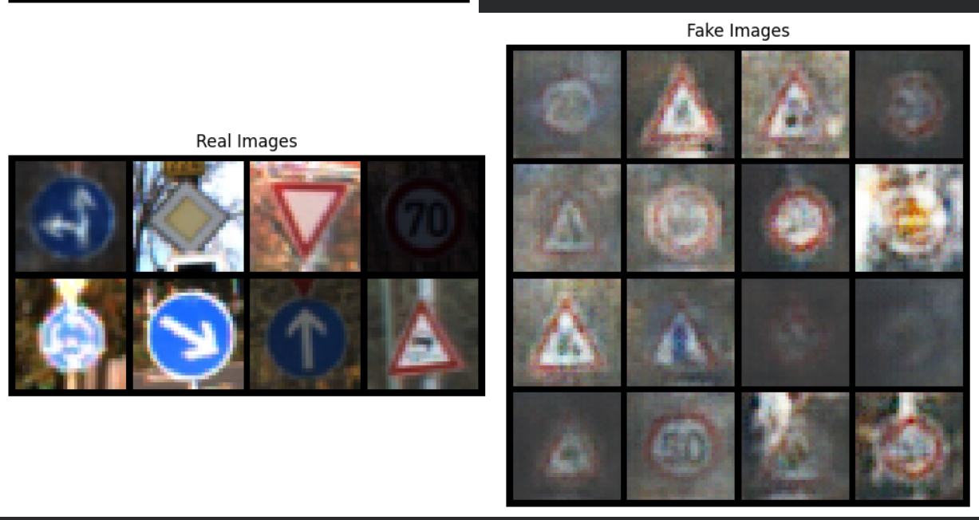
DCGAN Pipeline
A DCGAN model trained to generate synthetic traffic-sign images using a generator–discriminator framework.

Slide 14
Future Enhancements
Model Improvements
Incorporate ensemble models and attention mechanisms
Explore advanced CNN/Transformer architectures
Apply model quantization for efficient edge deployment
Data expansion
Add international traffic signs and synthetic data (GAN-generated samples)
Include more challenging conditions (nighttime, rain, snow, glare).
Deployment
Export to ONNX for real-time inference.
Optimize using TensorRT.
Integrate with live video processing pipelines

Slide 15
Conclusion and Key achievements
Built a high-accuracy, deep-learning traffic sign recognition system using both custom CNNs and transfer learning
Designed a complete pipeline covering data loading, preprocessing, augmentation, model training, tuning, and evaluation.
Achieved strong generalization across all 43 classes with stable training behavior and minimal
Key Achievements:
A lightweight custom CNN + optimized ResNet-18 transfer learning model.
Effective regularization: augmentation, dropout, early stopping, LR scheduling.
Fully reproducible, well-documented code suitable for real-world deployment

Slide 16

Thank You

